Slide 1
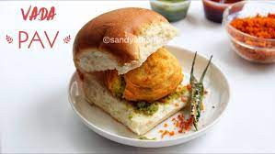
Business Start Up and Sustainability
DATA SCIENCE AND –SOLUTION OVERVIEW

Slide 2
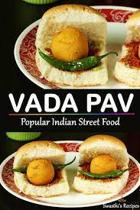
Agenda
1. Introduction,
2. Problem statement & Data Source
3. Objective & Methodology
4. Solution Description
5 . Impact

Slide 3
1.Introduction,
Now a days before starting a business need to select
various strategies which helps in growth and profits making of the business.
A business man wants to open a Wada Pav shop near Shivaji Nagar in Pune.
Were there are already 4 Wada Pav shops are running from long days.
How this new business man will run the shop in profits with the competitors with continuity business.
Help him making profits in business.

Slide 4


2. Problem Statement and Data Source.
* What will be the Price of each Wada Pav.
* How will he differentiate from other competitors.
* How will you bring insights when he has no data of his shop?
* Why will the Customer come to your shop? (What will be the positioning)

Slide 5
3. Objectivity and methodology
Help in setting up the business.
Identifying the strategy to profit the business.
Increase the customer population.
Understanding the various customers tastes and competitors strategies in growing the business.
Setting the competitive price to attract the customers.

Slide 6
4.Solution Description
Opening first day of business by selling Wada Pav at less rate to advertise there product.
Selling the wada pav at Rs. 25/- will attract more customers.
Providing different discounts on special days like Holidays and Sundays .
Providing different packages on mostly sold menus will also increase profits.
Maintaining clean ,quality of food and services also effect profits.
Keeping free delivery on minimum order with in specified areas.
Using social media and food apps to increase the business.

Slide 7
5.Impact
By selling the wada pav in initial days of business may bring loss or break even point with low rates.
He has to continue the same price with different packages to attract customers with strategies.
Customers increase in purchases means the growth in business later he can increase the price to market level.

